Slide 1
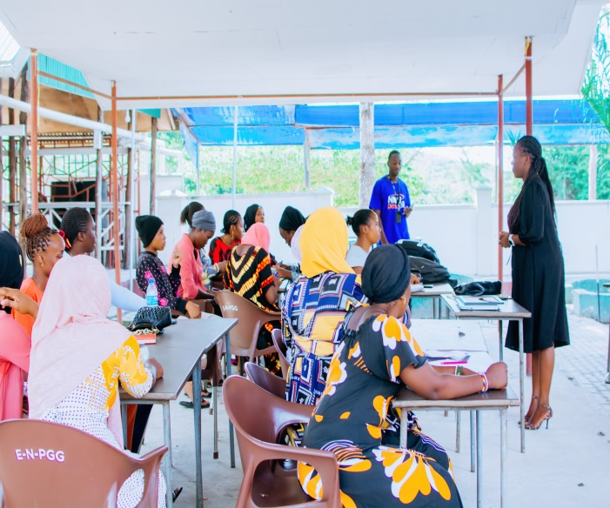


Slide 2
Tycc Overview
Tanzania Youths Competence for Community is Non -Government Organization advocating youths and young women rights to economic empowerment.
Our Vision “To see youths of Tanzania becoming competent and serve as the catalyst of positive changes to themselves, their society and the world at large.
Our mission “To support and promote the provision of quality, conducive growing environment for youths potentials innovation and opportunities in collaboration with government and other stakeholders.
From 2019 TYCC operated as a college club until August 2021 where we got registered with number: 00NGO/R/2092
Since then, we initiated programs for health awareness campaigns ( HAINA KUSHINDWA), leadership, Financial literacy Touching the lives of more than 2,000 youths (directly)
We remember to give up not once not twice, but once we got opportunity to be part of Dadas Rise Network, we have been encouraged, empowered, received more opportunities and here we are to our very first funding support we ever received.

Slide 3



Our Story
Tycc started as a girls’ club at College of Business Education, being there as a girl who did not receive a fee support from Government board, with poor parents from our extended family where everyone wanted to take from a small source, has never being easy.
Luckily, meeting with girls from the same background has boosted the courage to unite and share experience while searching a way out and even started small business while at college.
The eagerness to survive , strive and at least hoping to achieve not only for our sake but also for the whole community , we started to organizing girls around the community, encouraged, and empowered them to fulfil their potential.
we have been doing the initiatives through seminars, online convoys', and social medias engagements

Slide 4

Our Approach
Digital finance service
Financial Empowerment
Convenience environment
Gender Equality
Capacity Building
Advocacy
Opportunities diversification
FinancialFFinancial
Digital Finance Service
TYCC
Vestibulum congue
Gender Equality

Slide 5
Impact and Results
80 young women and girls direct and 2,000 indirect,reached out.
1
2
3
4
5
Young women become capable to stand for their rights
Creating and providing opportunities for young women expand their businesses.
Young women and girls games financial skills for savings, and simple investment and become a part of financial decisions in their households.
Networking young for safe savings and wealthy mindset generation in savings digital groups. groups,
Women engaged into different economic activities, and becoming part of positive movement in their societies.

Slide 6
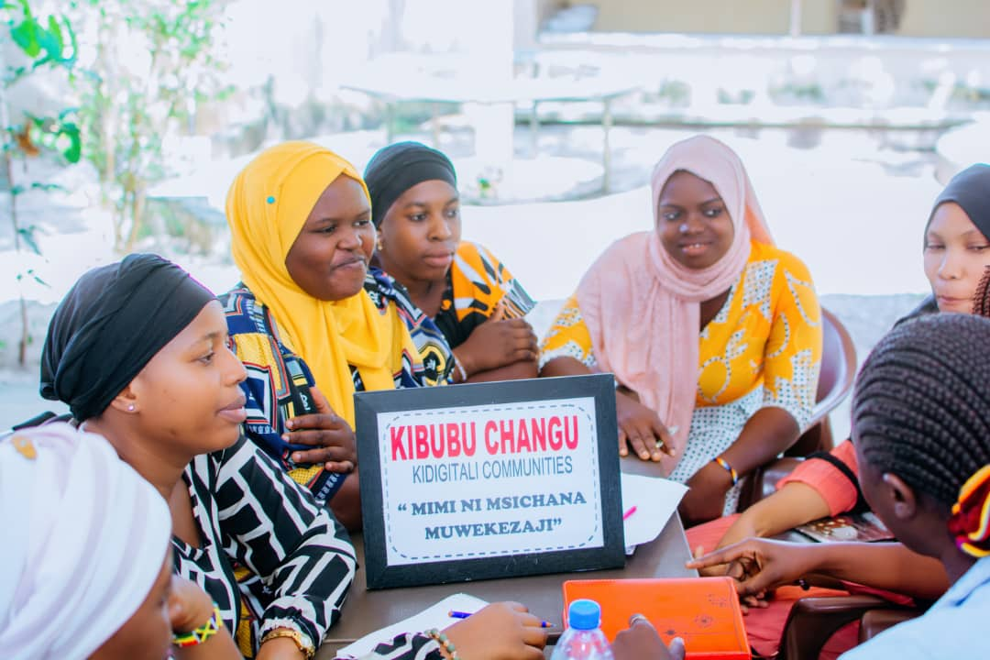
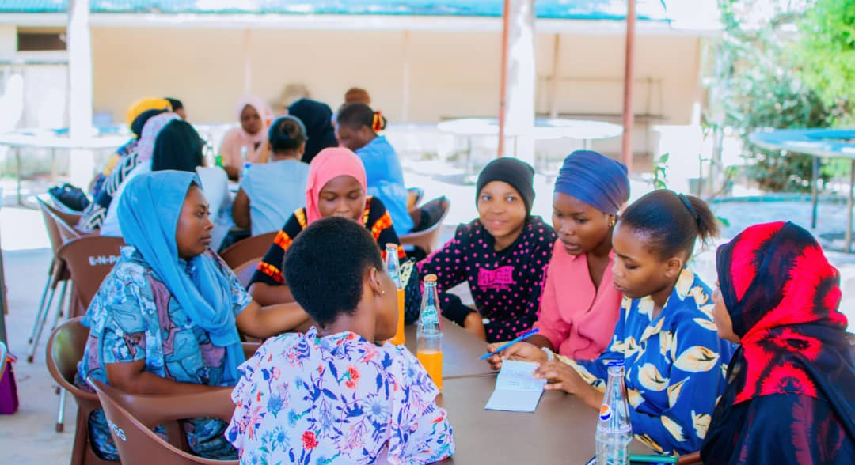
Impact and Result
Awareness raising (1,500 beneficiaries)
5 Financial groups formation such as KIZOTA and VIWANDANI from Dodoma region, KIBUBU QUEENS and KIBUBU LADIES from Kisarawe District.
Provide inspiration to disadvantaged girls
Advocate for more resource allocation to girls access to finance

Slide 7
Achievements and Financial Projections
T
S/N | PRESENT | FUTURE
1 | Up to 2026 reach out 8,000 young women and girls, direct and indirect with USD 2,500 | 2027-2030 reach out 25,000 young women and girls. USD 80,000- 100.000
2. | Empowering Young women and girls with Financial literate skills, entrepreneurship trainings, digital awareness, gender equality seminar, and life skills. | Creating convenience environment, fostering sustainability for girls and young women economic and financial freedom . Through strengthening young women financial literacy groups , initiating safe, simple and easy digital financial platform for resources mobilization, safe savings, investments and markets, for young women’s business growth a in Tanzania, and creating centers for entrepreneurship skills and opportunities in vulnerable areas.

Slide 8
Awards And Recognitions
2024: Financial Literacy Award
2024: Youth led NGO Award

Slide 9
The Ask
Champion :
Young women Financial and Economic Empowerment
Invite:
Connect Tanzania Youths Competence for Community with philanthropists, partners, forums and platforms supporting young women economic rights and justice
Invest:
Long-term development partnerships / funders
Donation Sites:
Feminist Fund for East African Girls and Young Women

